Slide 1



Slide 2

OUR TEAM
25075011
Allamaneni Amulya
25075038
Burra Nishitha
25075042
Datti Sowmya
25075050
Gorantla Vyshnavi
25075076
Makkena Lakshmi Prasanna

Slide 3
Problem Statement:
Planning a trip manually requires searching for destinations, calculating travel time and expenses, finding suitable accommodation and food, and deciding which places can realistically fit within the available time and budget.
Current Difficulties:
  Too much scattered information
  Difficult to estimate total trip cost
  Difficult to plan multiple destinations efficiently
  Limited time and budget may force users to remove places manually
  Information about permissions/registrations is often difficult to find
  Different users have different preferences

Slide 4
Proposed Solution:
Our system is an intelligent travel planning platform that generates a personalized and feasible trip plan based on the user's location, radius, selected destinations, budget, number of days, starting point, ending point and preferences.
User Input
Place Discovery
Filtering
Route Planning
Budget/
Time
Optimization
Itinerary

Slide 5
Main Objectives:
Discover nearby tourist destinations within a specified radius
Provide meaningful information about each destination
Generate a personalized travel itinerary
Consider budget and available time
Suggest accommodation and food options
Estimate transportation/travel expenses
Identify destinations that cannot be included and explain why
Provide information about required permissions/registrations
Reduce the effort required for manual trip planning

Slide 6
Key Features:
Destination Discovery
Radius-based place search
Trip Planning
Start/end points
Budget Management
Travel cost
Place categories
Historical/cultural information
Entry fees and visiting duration
Number of days
Selected destinations
Route generation
Hotel cost
Food cost
Entry fees
Total estimated cost
Personalization
Hotel preference
Smart Filtering
Time constraints
Information Assistance
Permission/registration requirements
Food preference
Transport preference
Budget constraints
Unavailable destinations + reason
Official links/process information

Slide 7
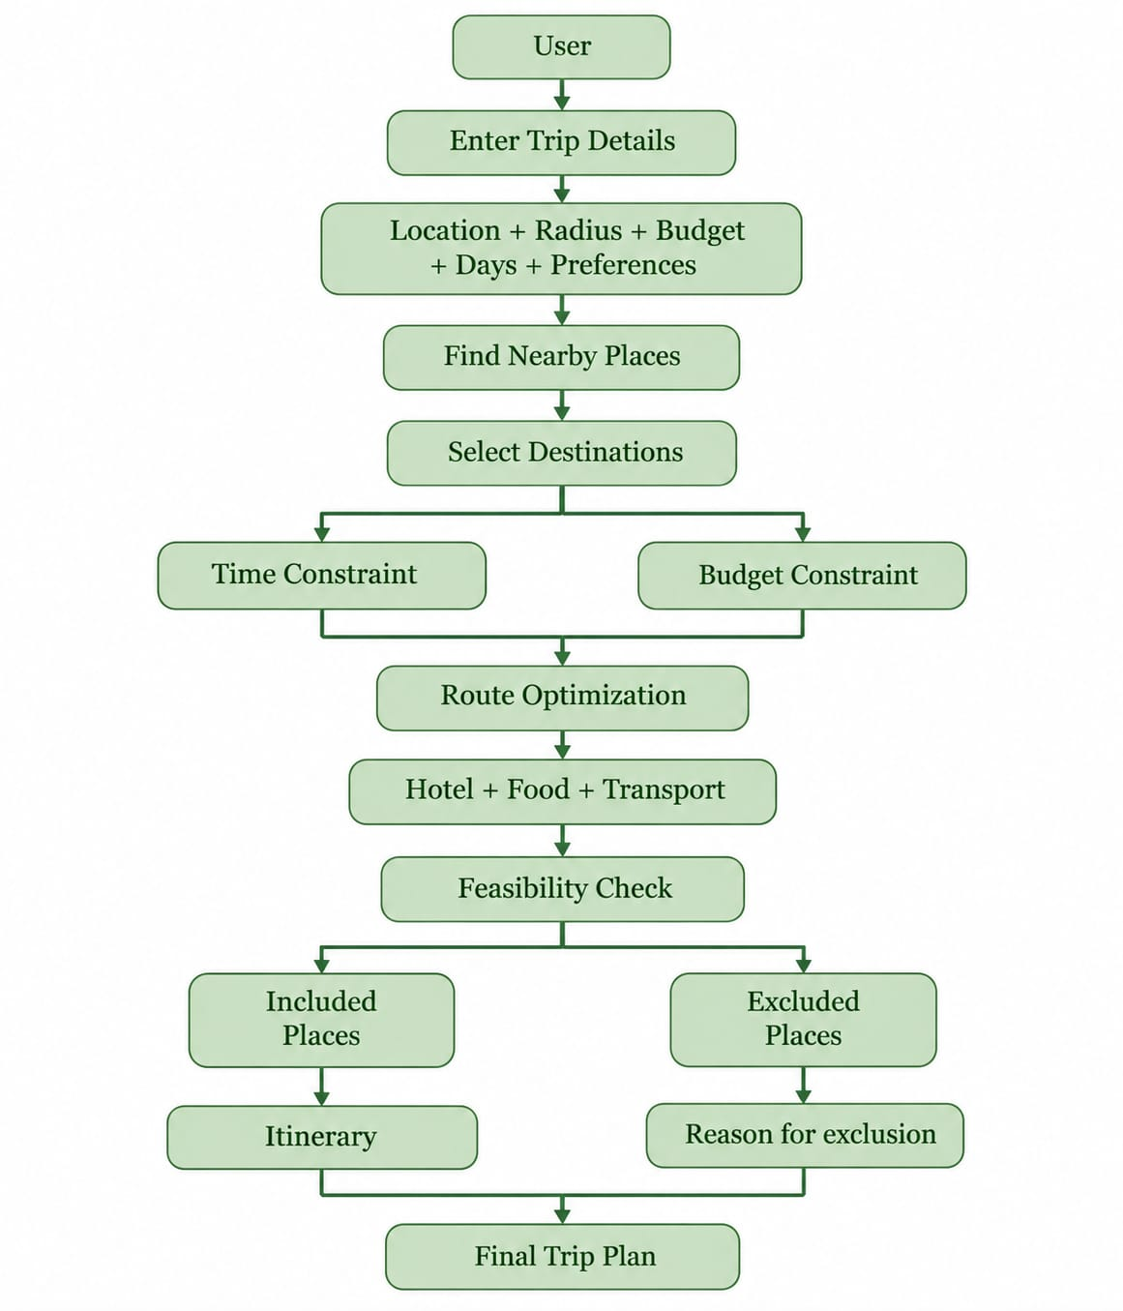
How the system works:

Slide 8
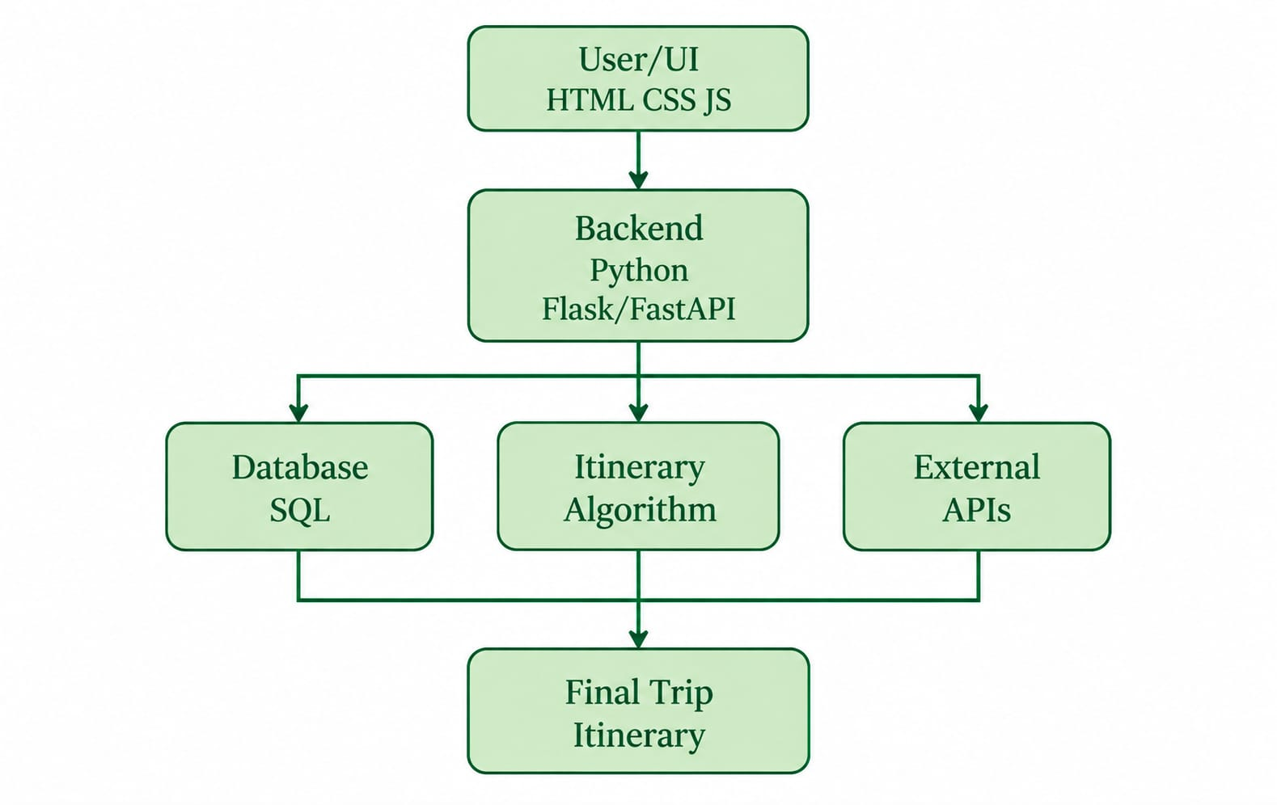
System Architecture:
Tech Stack
Frontend: HTML, CSS, JavaScript
Backend: Python + Flask/FastAPI
Database: MySQL/PostgreSQL
External services: Maps/routing/location APIs where required
Algorithm: Constraint-based itinerary/route optimization

Slide 9
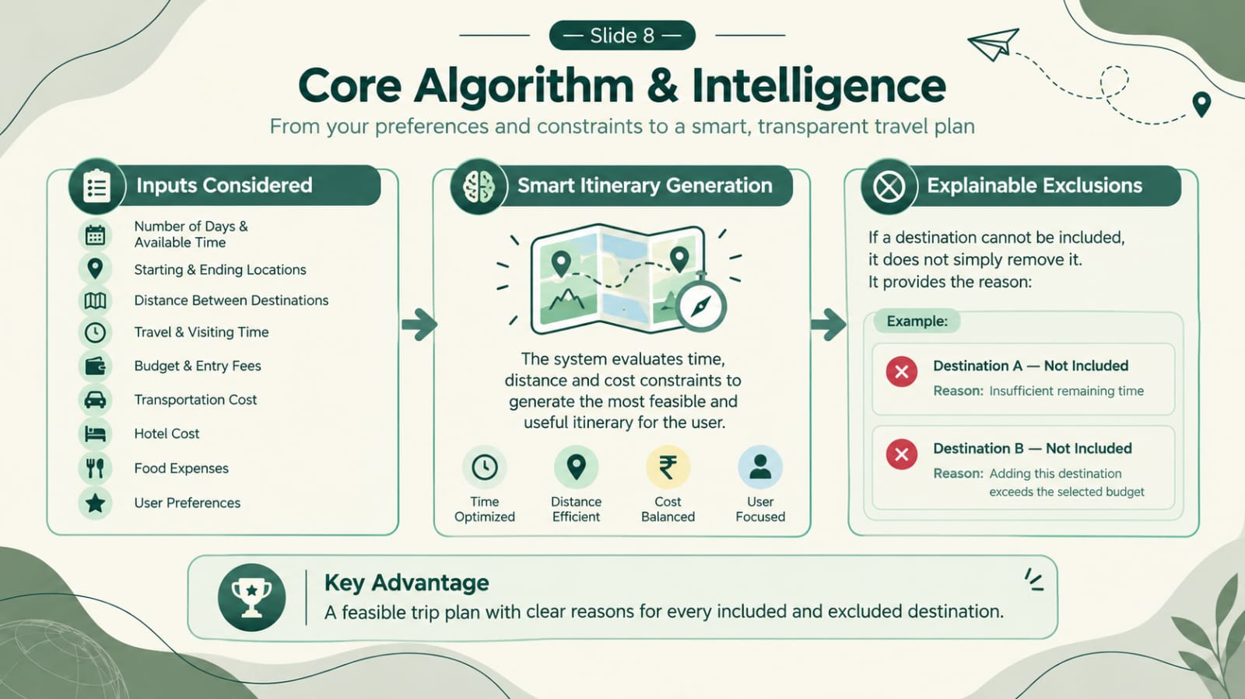

Slide 10
Database:
Place
Place ID
Name
Hotel
Name
Location
Category
Visiting Duration
Entry Fee
History
Location
Category
Price
Food
Name
Cuisine
Permission
Place
Requirement
Location
Average cost
Procedure
Official link

Slide 11
Technologies & Domains Used:
Domain | Usage
HTML/CSS | Website interface
JavaScript | User interaction & frontend communication
Python | Backend and processing
SQL | Storing travel data
APIs | Location/routing/external information
Algorithms | Route and itinerary optimization
Shell scripting | Optional automation/deployment tasks
ML | Optional personalization/recommendation

Slide 12
What makes it different ??
Our proposed system
Combines these with:
Personalized constraint-based planning
Budget + Time + Selected Places + Start/End Point + Preferences → Feasible Itinerary
And particularly:
Instead of silently dropping destinations, the system tells the user why a destination was not included.
Existing travel platforms
Often provide:
Places
Maps
Hotels
General recommendations

Slide 13
Project Development Plan:
Phase 1
Requirement Analysis
Phase 2
Data Collection & Database
Phase 3
Frontend + Backend Development
Phase 4
Phase 5
Phase 6
Phase 7
Route & Itinerary Algorithm
API Integration
Integration & Testing
Optimization + Documentation

Slide 14
Future Scope:
Real-time traffic integration
Weather-aware itinerary adjustment
Live hotel/restaurant availability
Public transport integration
Personalized recommendation using ML
Multi-state / nationwide expansion
Mobile application
Dynamic re-planning during a trip
Voice-based travel assistant
Conclusion:
Our goal is to transform travel planning from a manual search-and-calculation process into a personalized, constraint-aware and explainable trip planning system.

